Slide 1
Superstore Sales Project
بسم الله الرحمن الرحيم
Team members
Eng. Hesham El-Khawalka
Eng. Amr Muhammed
Eng. Mahmoud Abdelghani
Eng. Muhammed Ali Farouq
Data Analysis BEH1_DAT1_Me1
Group No.3DEPI Graduation Project
Under Supervision : Eng. Yehia Adam & Eng. Moanned Elassal

Slide 2
Agenda
Recap.
Data Ingestion Using Python.
“EDA” Exploratory Data Analysis Using Python.
Data Cleaning ( Preprocessing) Using Python.
Feature Engineering.
Data Modeling & simple Chart Using Python.
Data Visualization Using Tableau.

Slide 3
Recap
Data Ingestion ( Data Loading ) : Load Data ( Superstore Sales) into python for analysis.
Data Exploration ( Exploratory Data Analysis - EDA ) : Gain an understanding of the dataset, identify patterns, and detect anomies.
Data Cleaning (Preprocessing) : Clean the data to remove errors, handle missing value & outliers, and format the Data.
Feature Engineering : Create new feature or modify existing ones to improve analysis and insights.
Data Modeling (Grouping and Aggregating Data ) & simple Charts using Python : Use grouping , pivot tables, and statistical models to analyze data
Data Visualization : Visualize data trends and insights Using Tableau

Slide 4
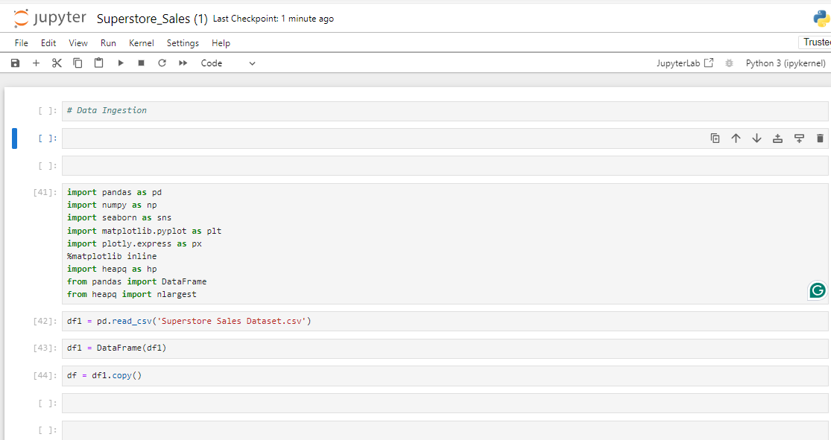
Data Ingestion

Slide 5
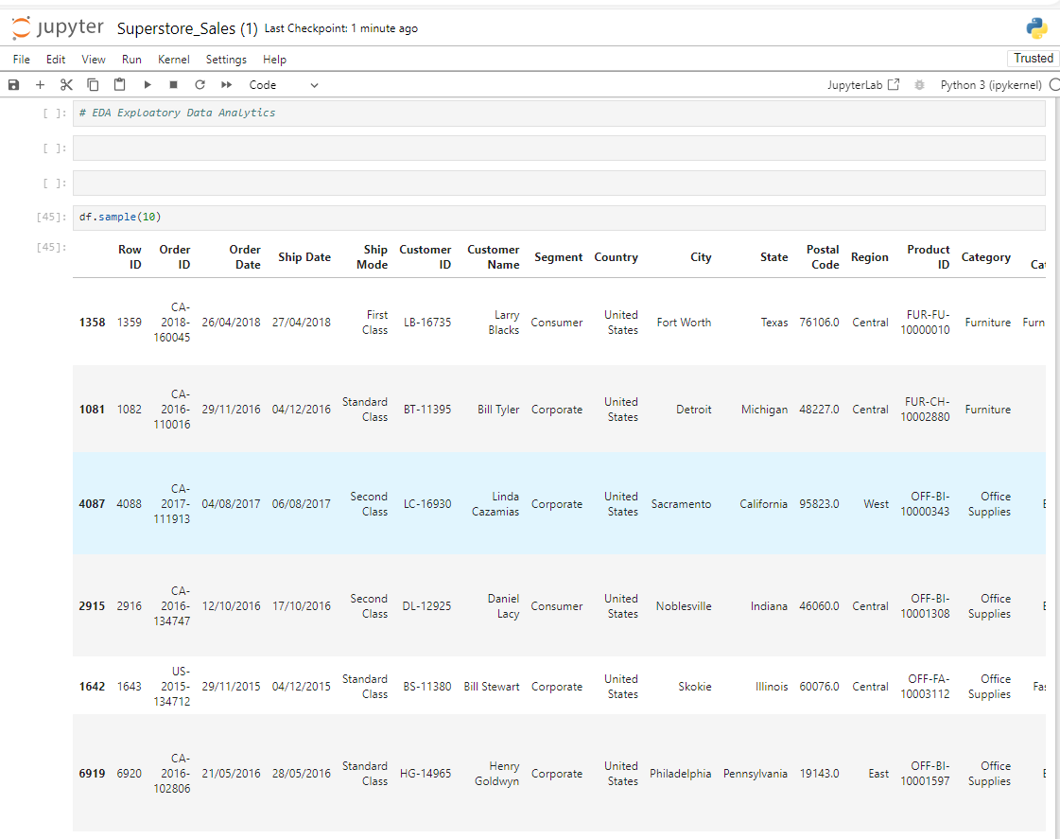
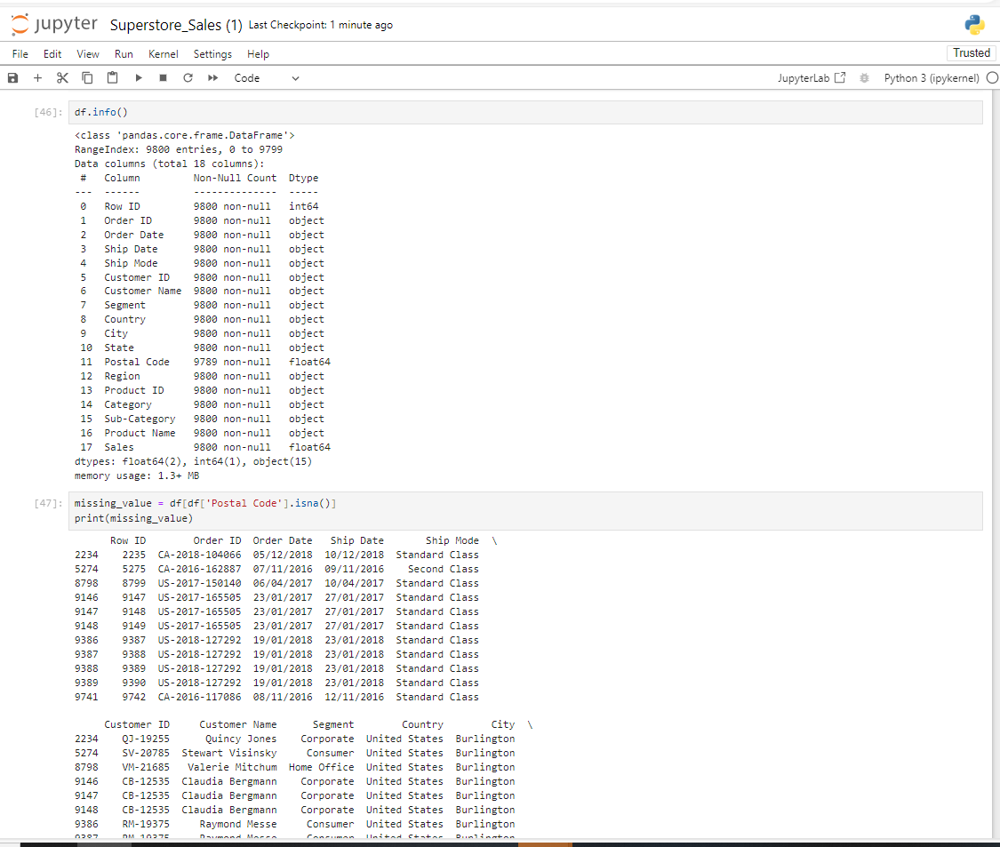
Data Exploration Or EDA

Slide 6
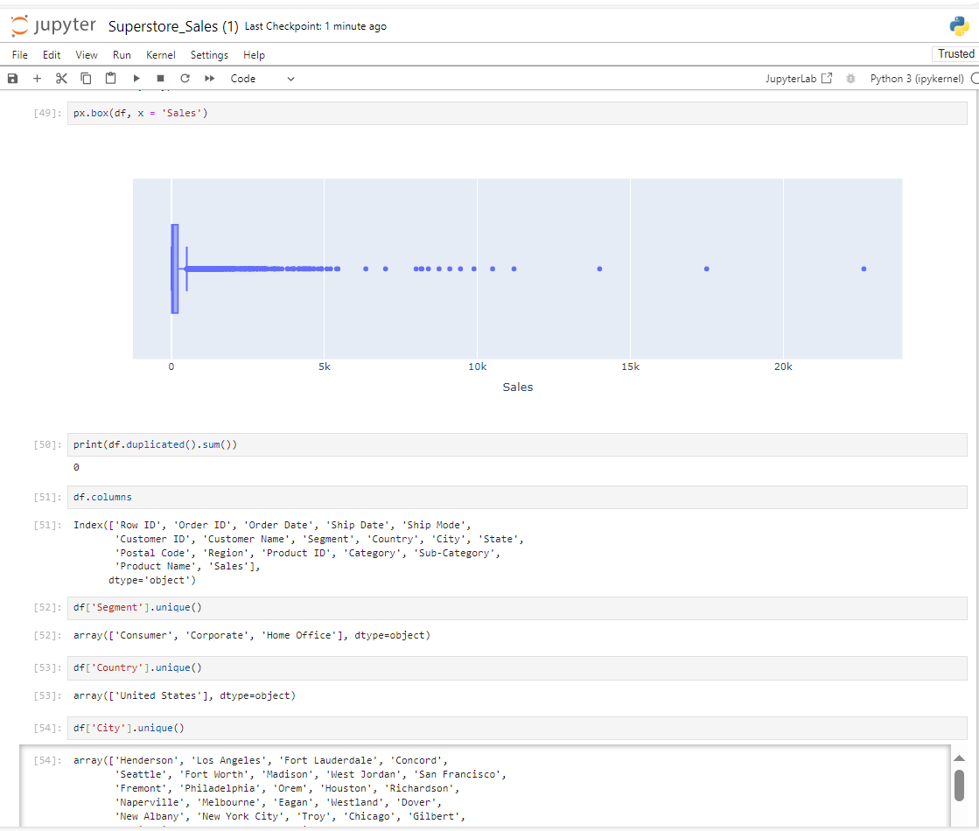
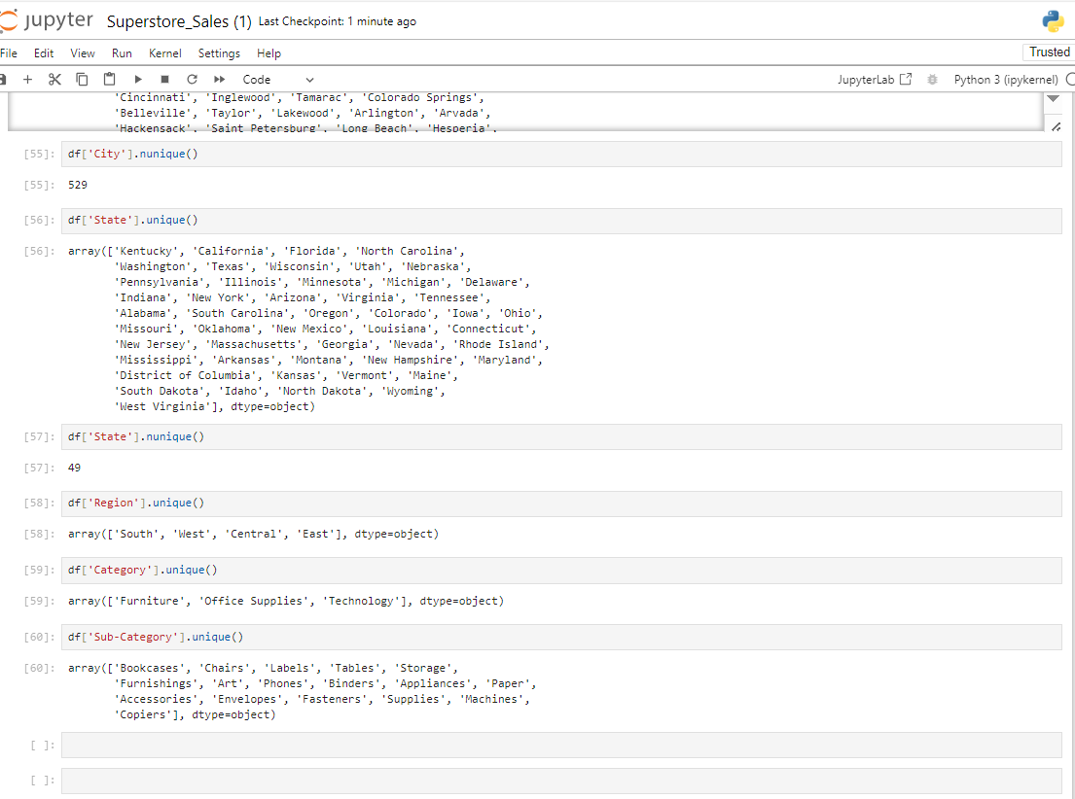
Data Exploration Or EDA

Slide 7
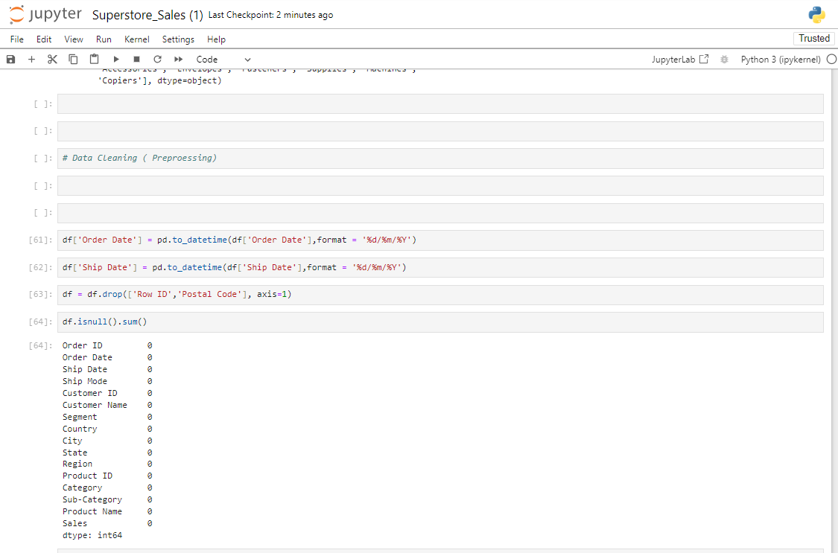
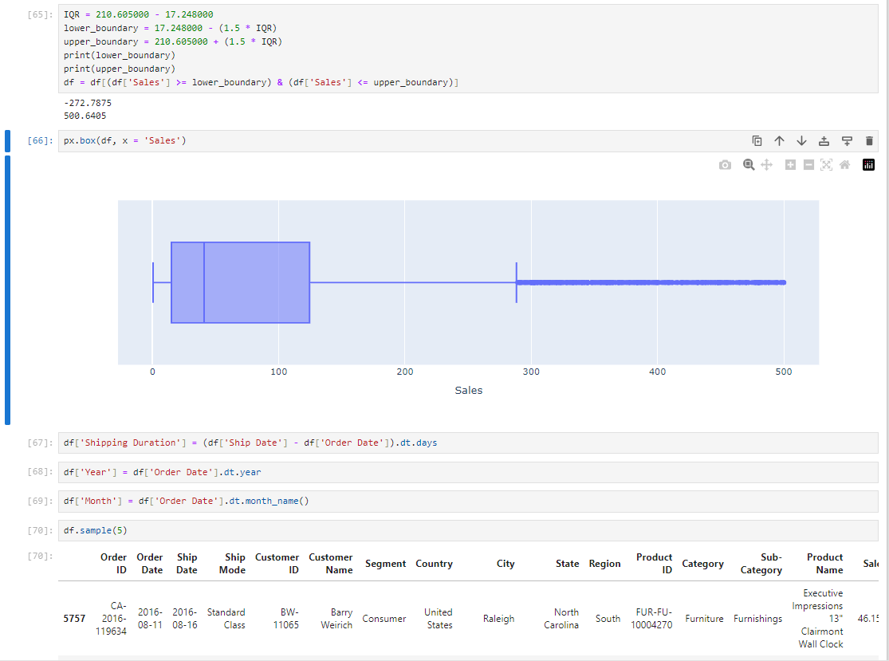
Data Cleaning & Feature Engineering

Slide 8
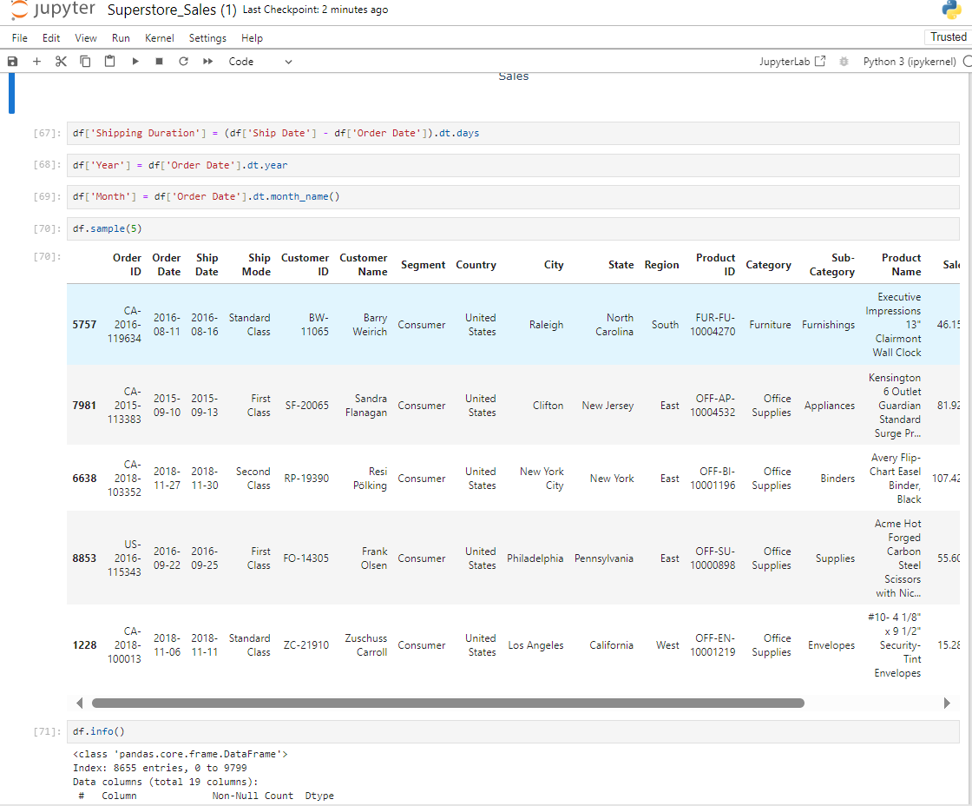
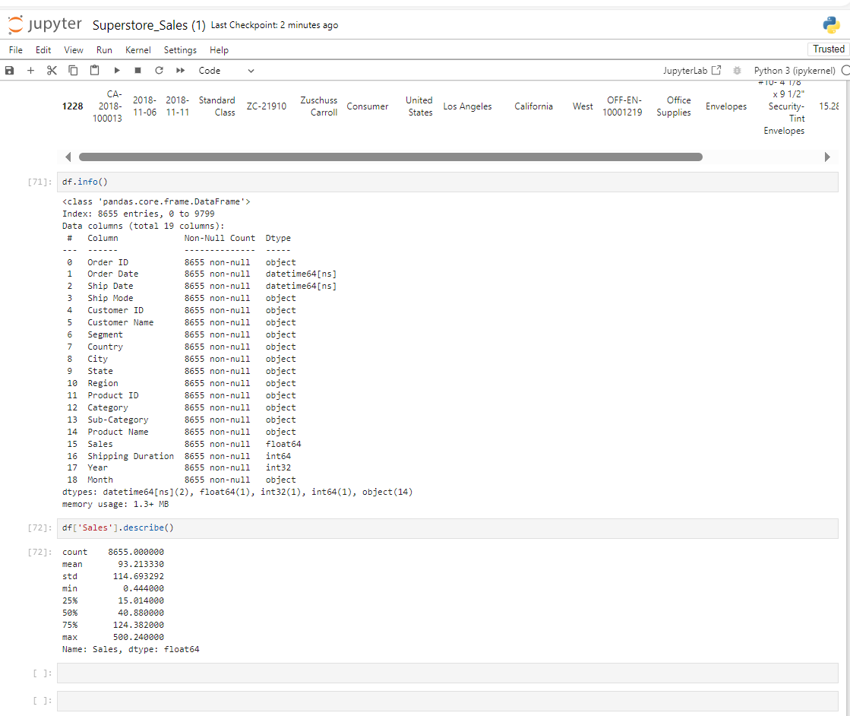
Data Cleaning & Feature Engineering

Slide 9
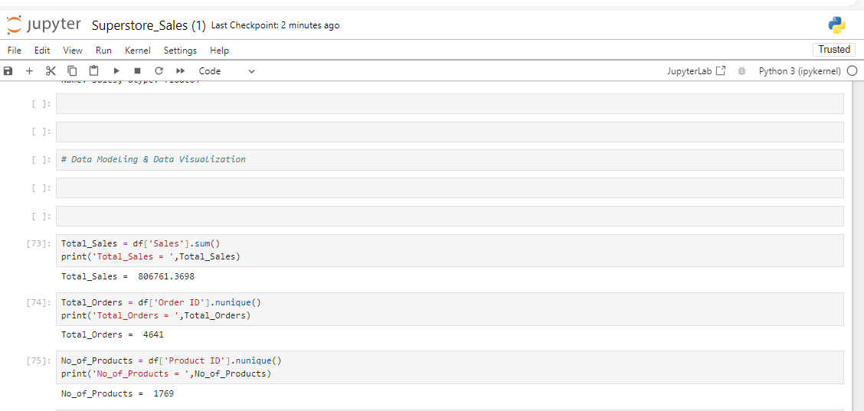
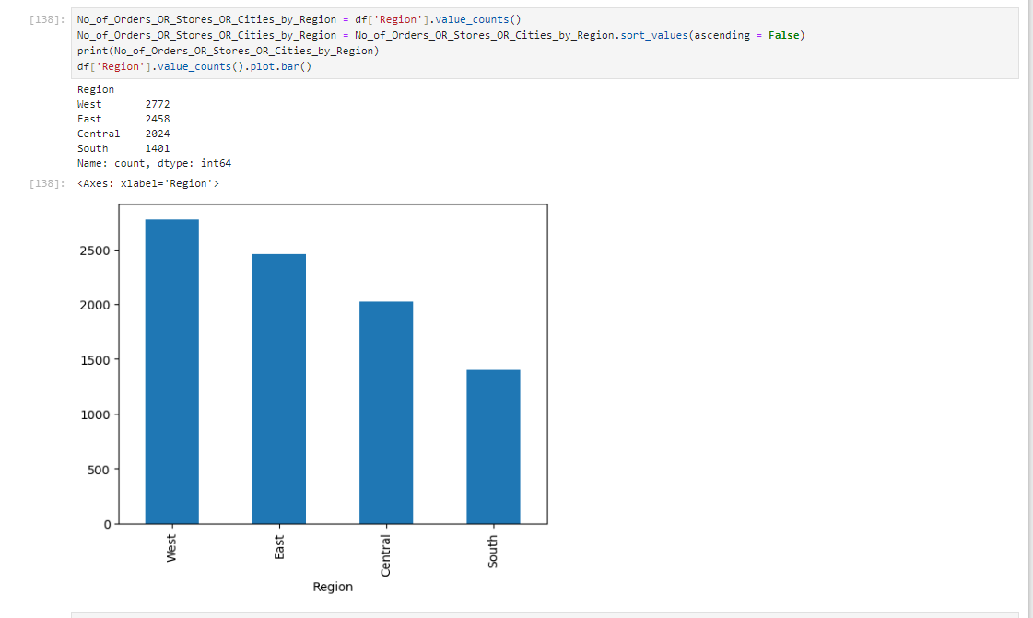
Data Modeling & Data Visualization Using PY

Slide 10
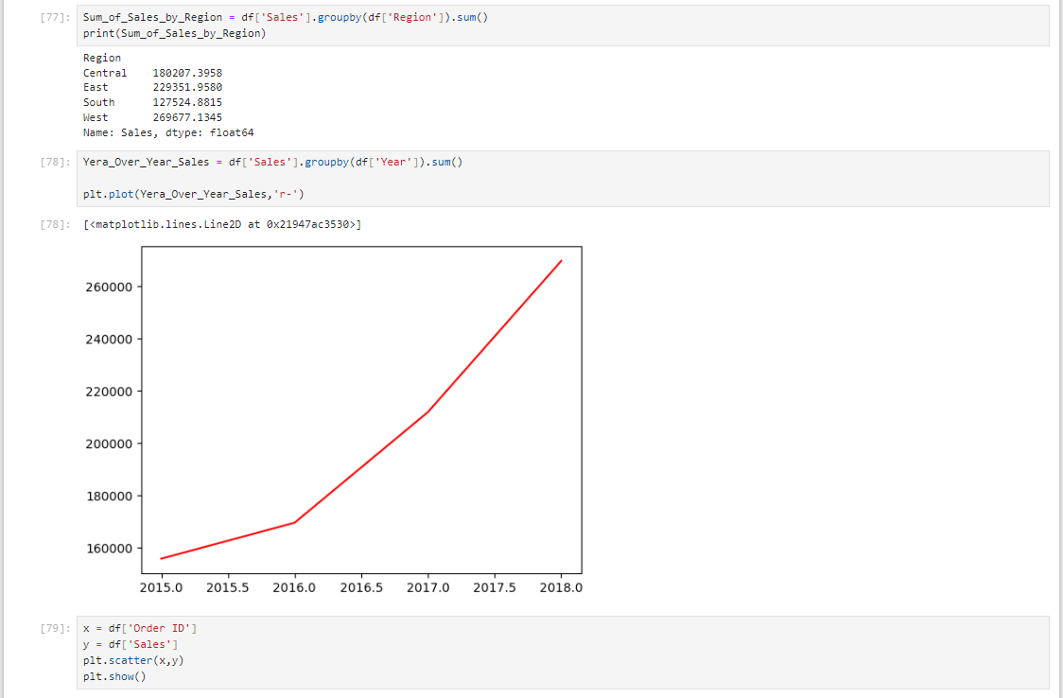
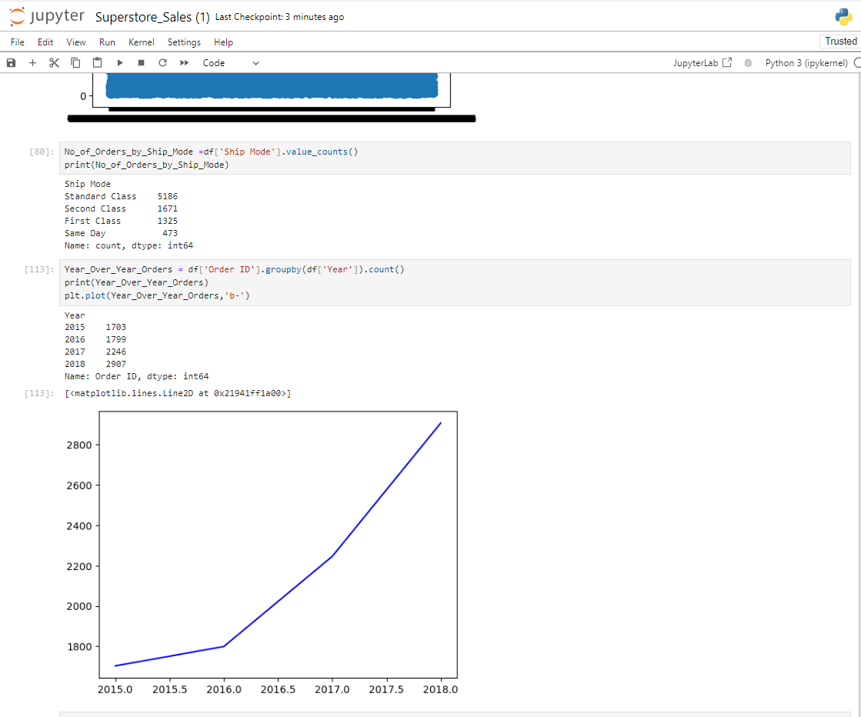
Data Modeling & Data Visualization Using PY

Slide 11
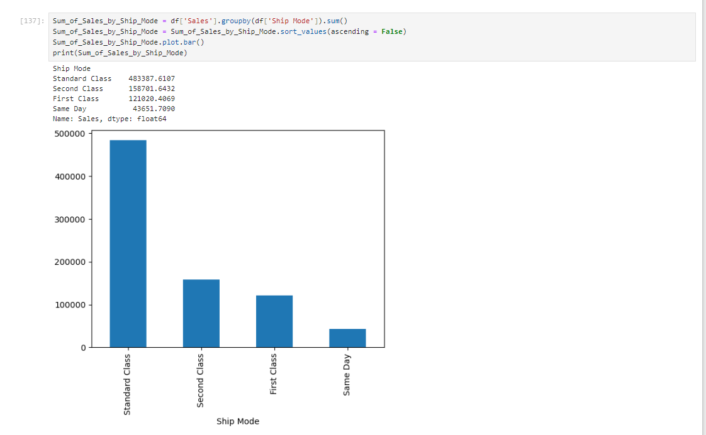
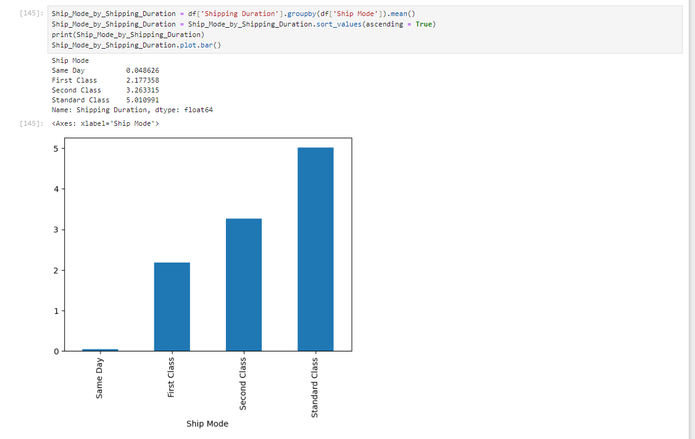
Data Modeling & Data Visualization Using PY

Slide 12
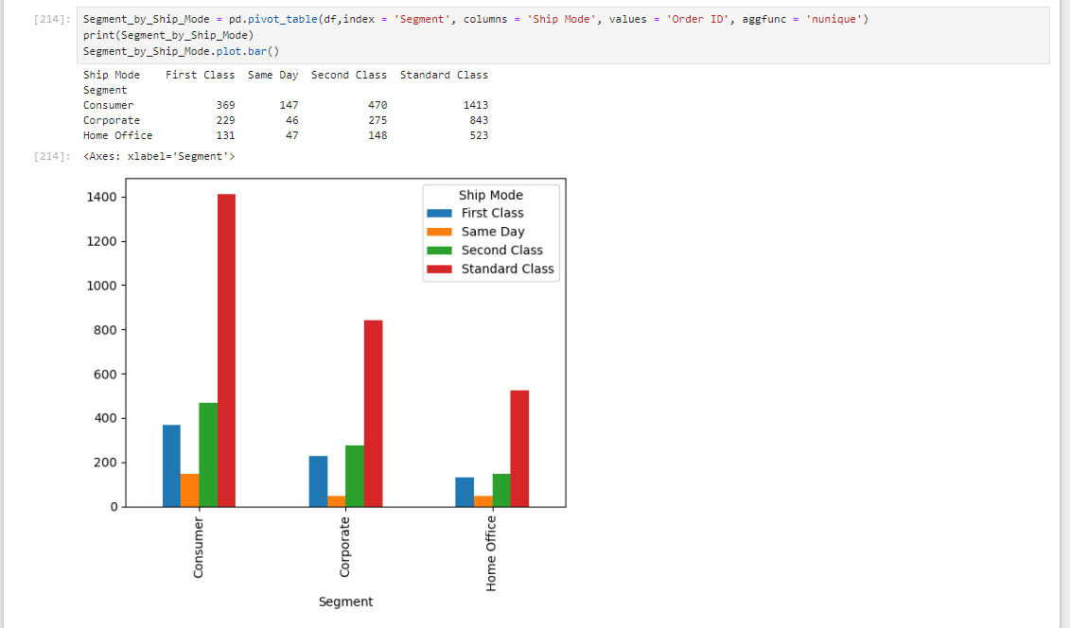
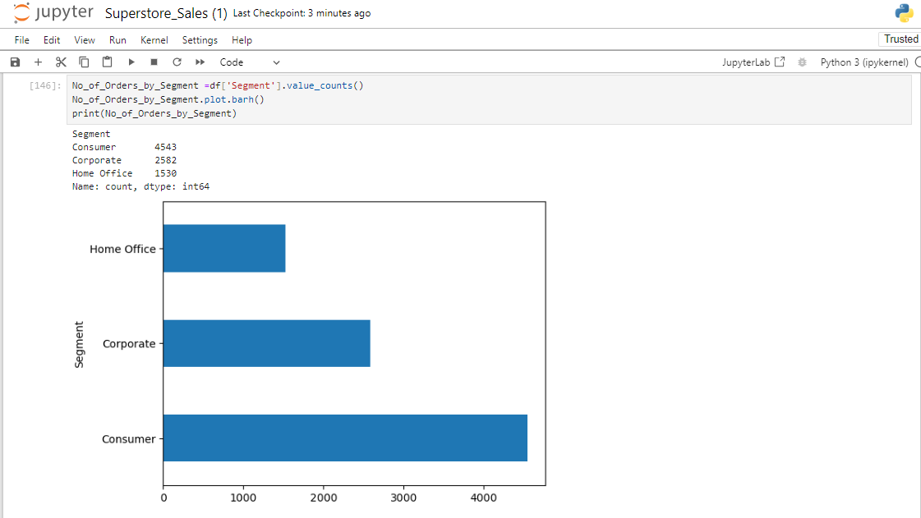
Data Modeling & Data Visualization Using PY

Slide 13
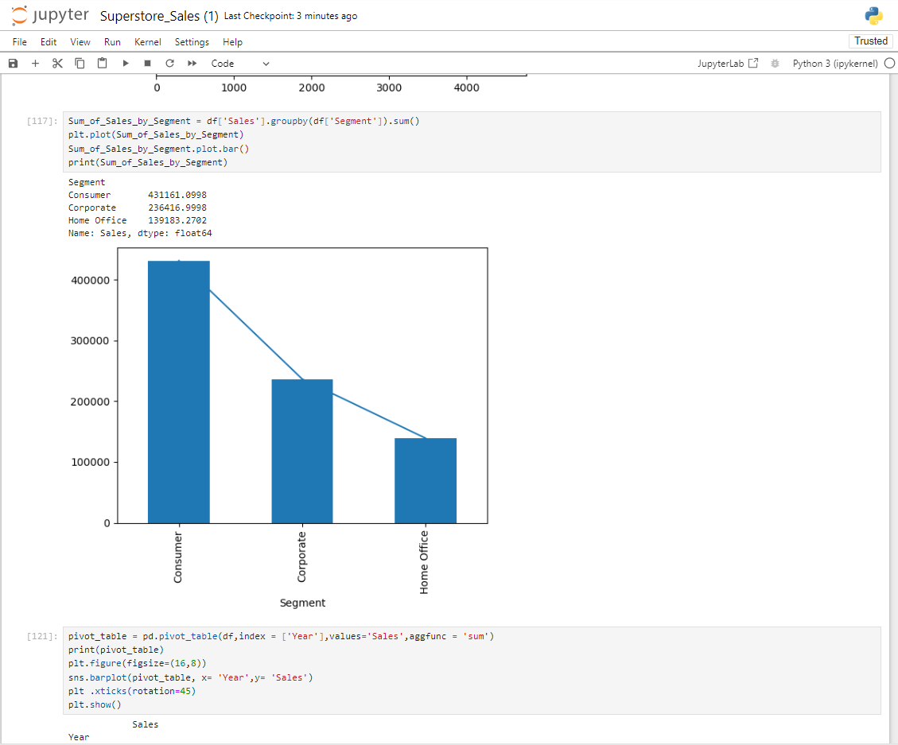
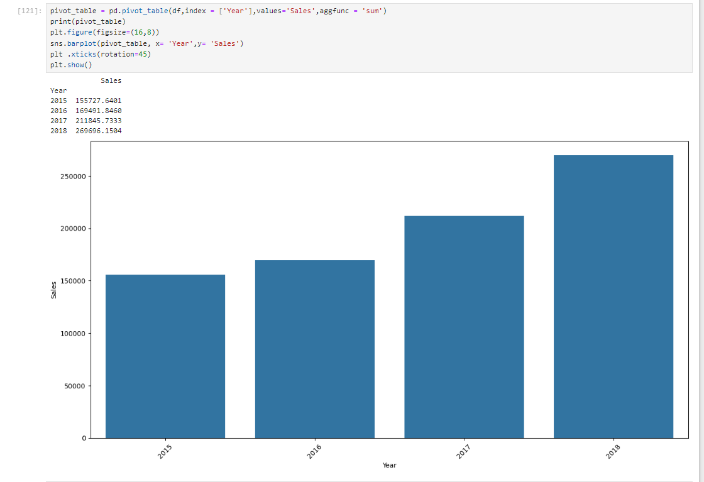
Data Modeling & Data Visualization Using PY

Slide 14
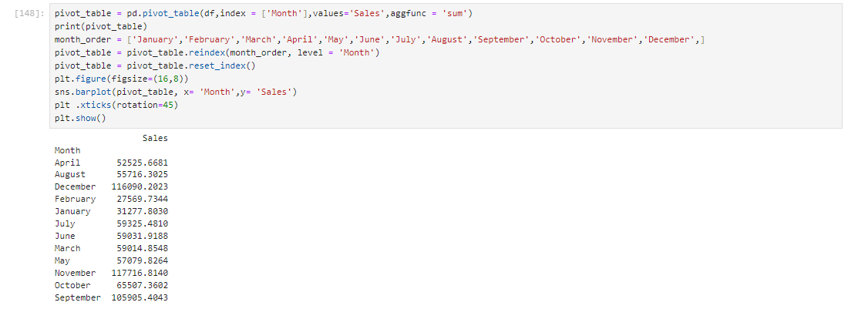
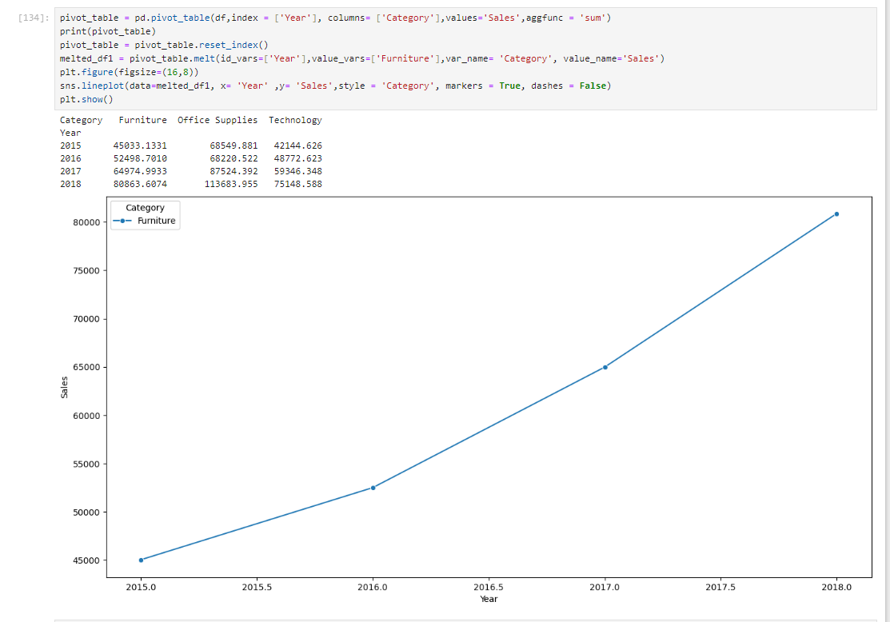
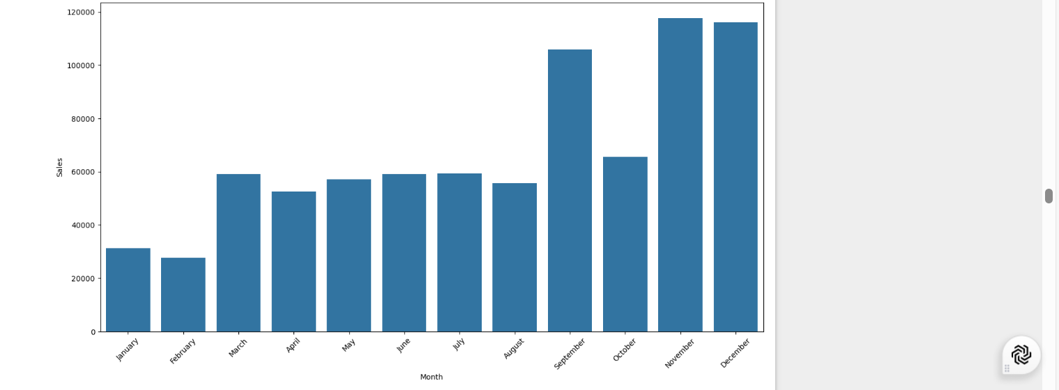
Data Modeling & Data Visualization Using PY

Slide 15
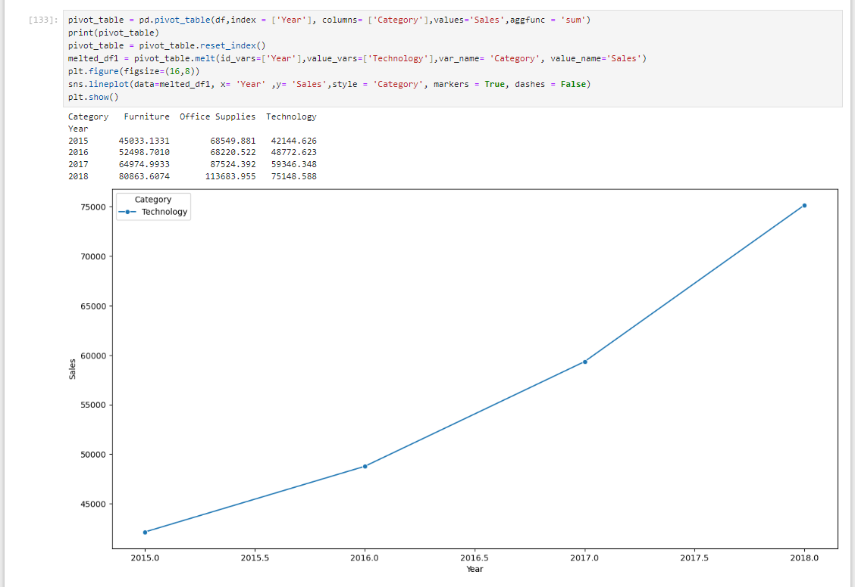
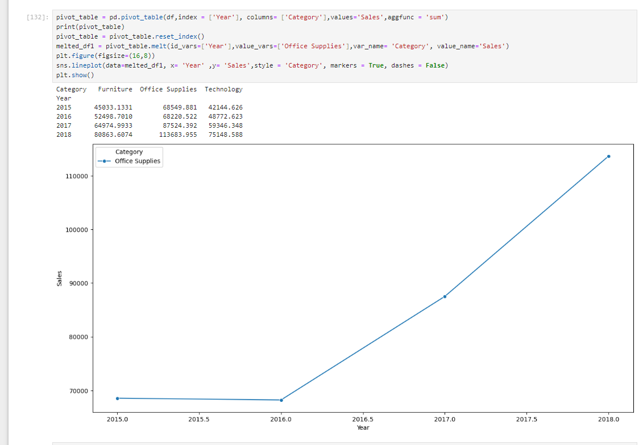
Data Modeling & Data Visualization Using PY

Slide 16
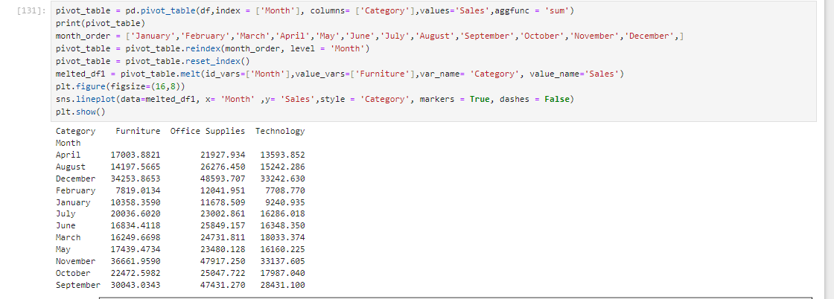
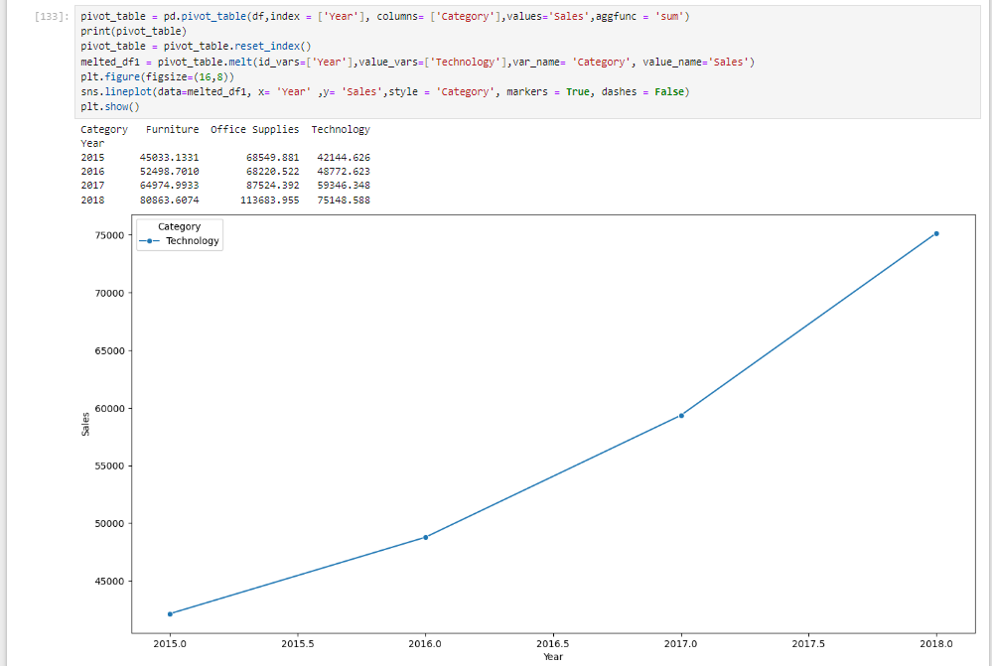
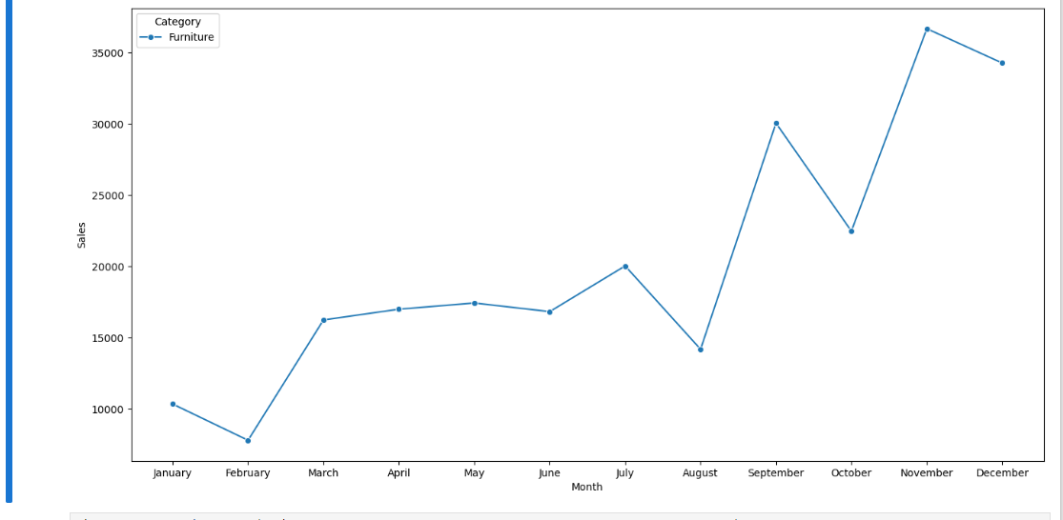
Data Modeling & Data Visualization Using PY

Slide 17
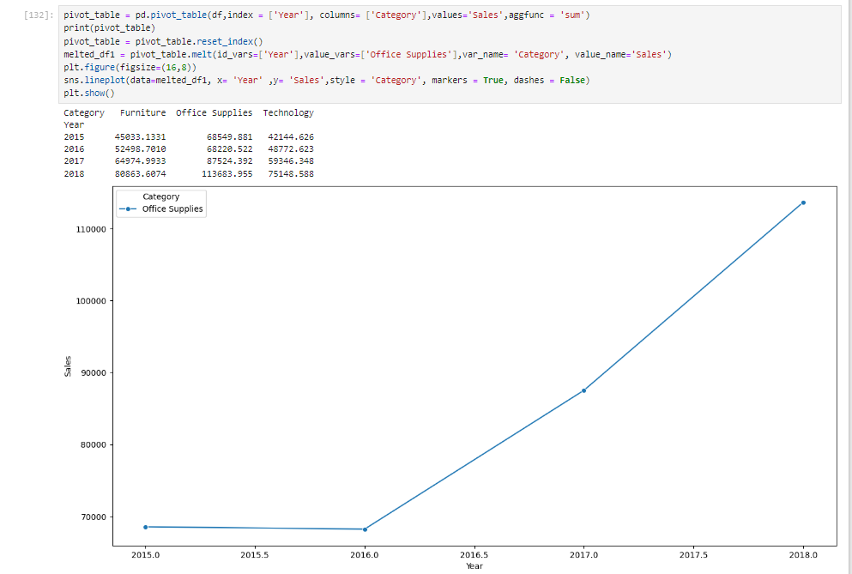
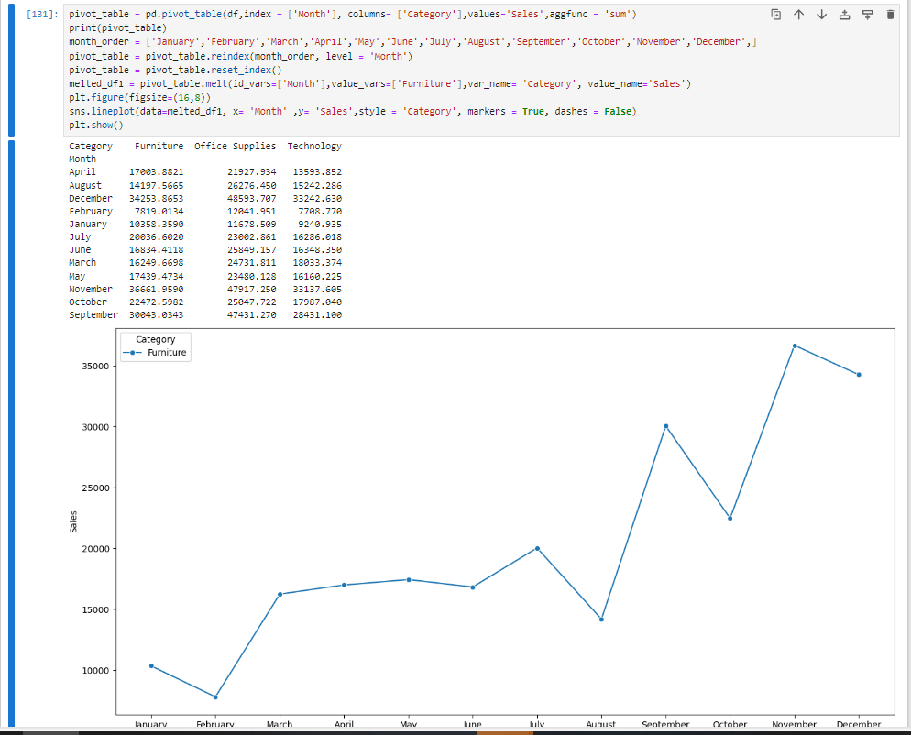
Data Modeling & Data Visualization Using PY

Slide 18
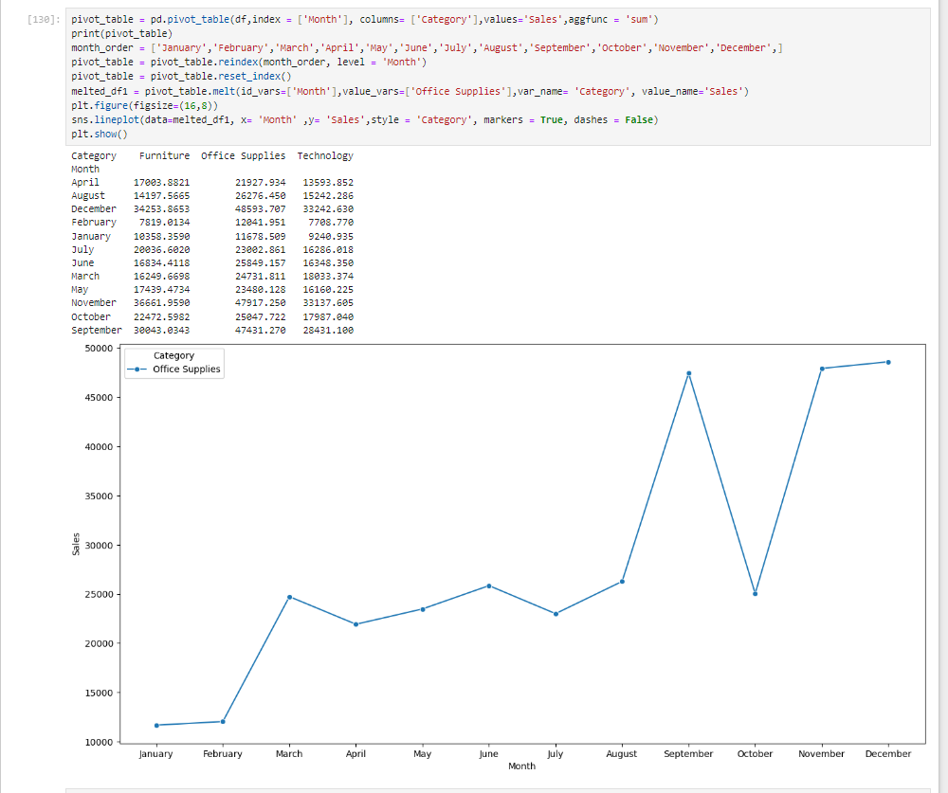
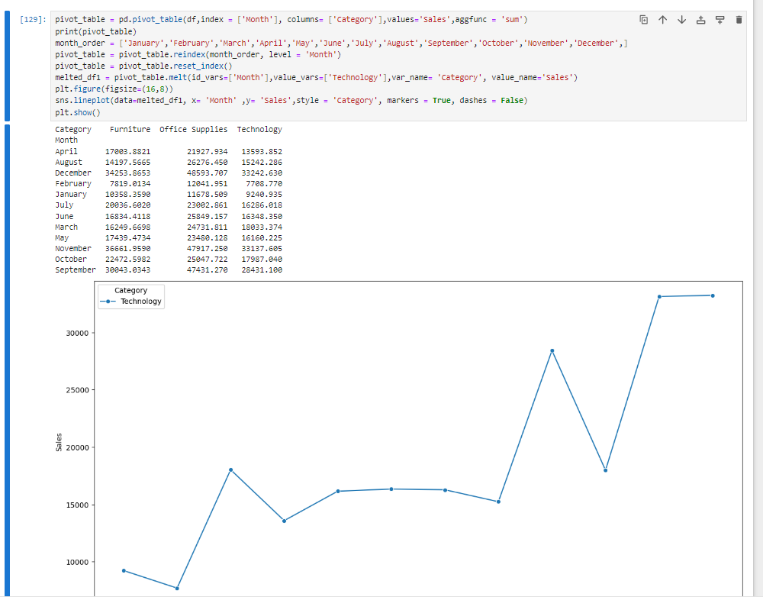
Data Modeling & Data Visualization Using PY

Slide 19
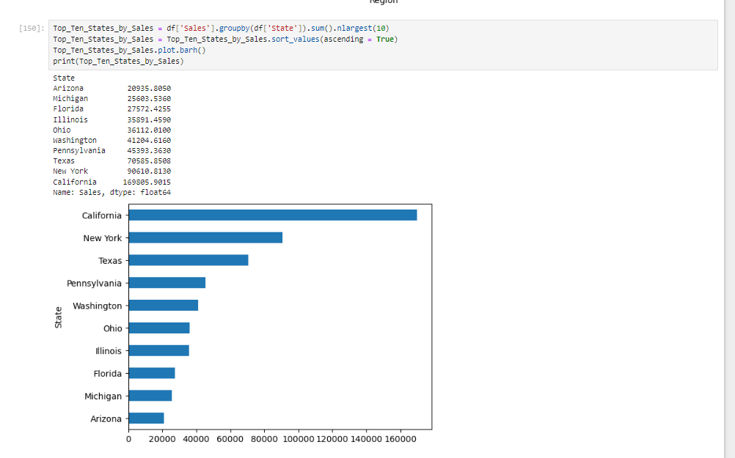
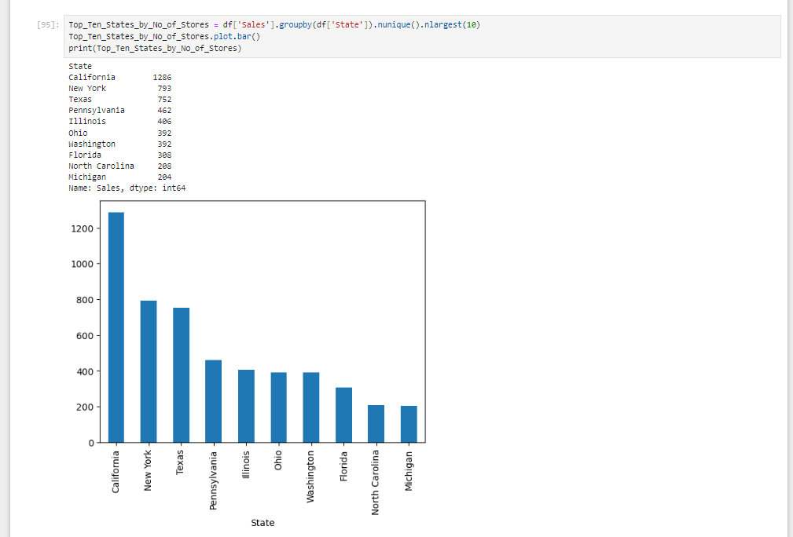
Data Modeling & Data Visualization Using PY

Slide 20
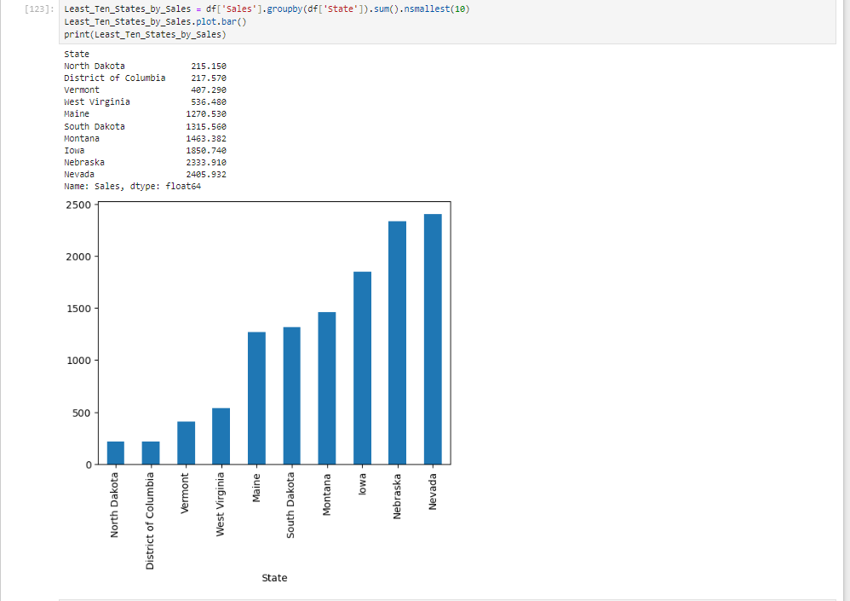
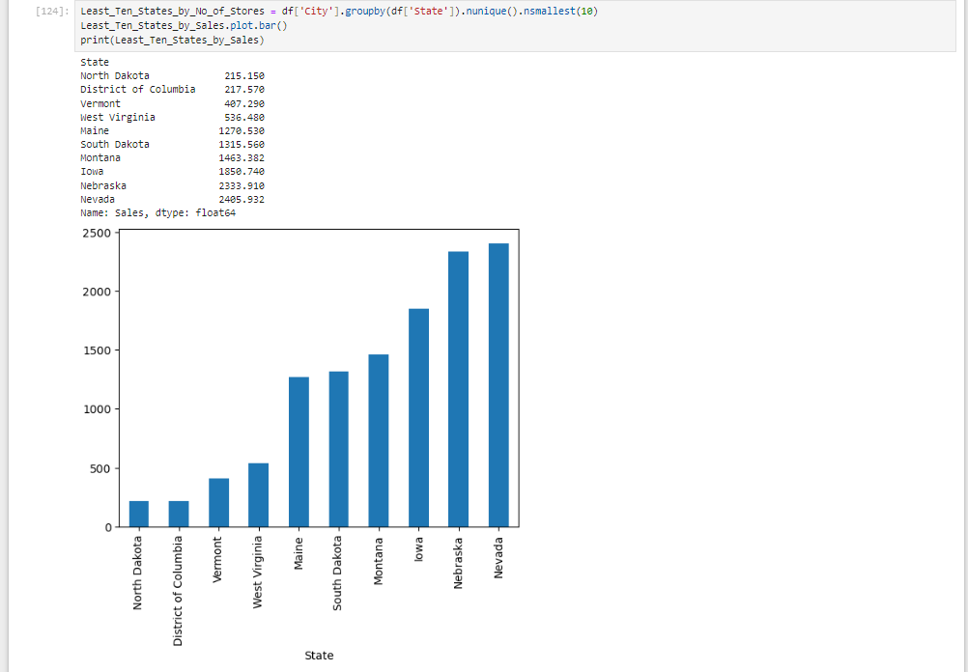
Data Modeling & Data Visualization Using PY

Slide 21
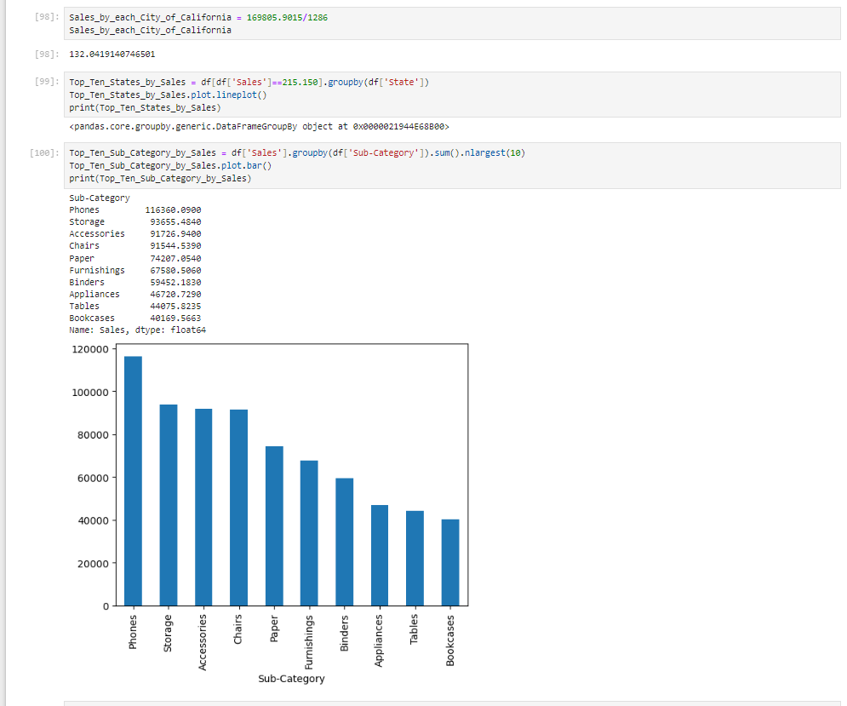
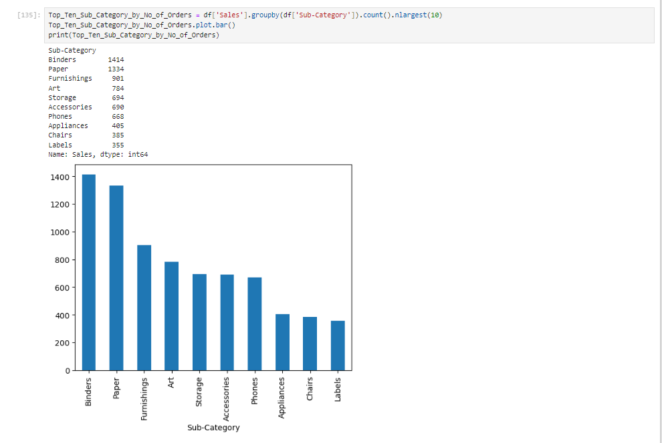
Data Modeling & Data Visualization Using PY

Slide 22
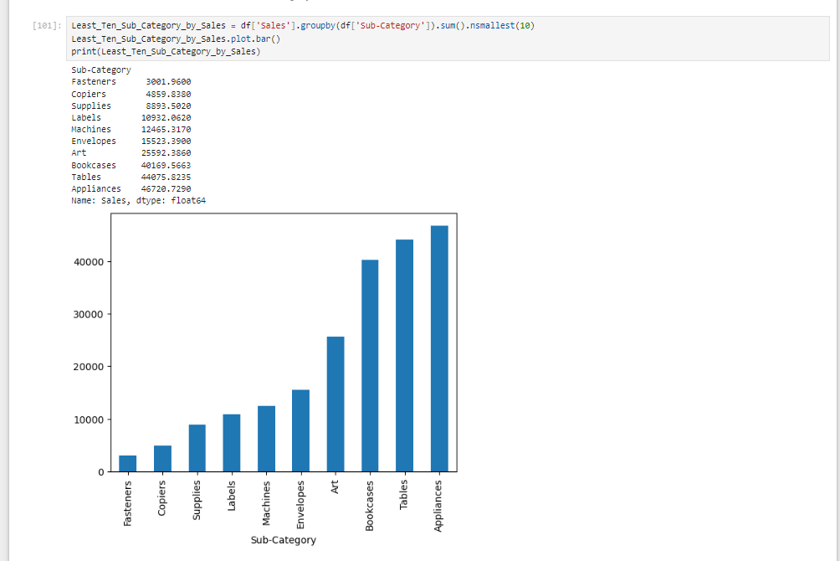
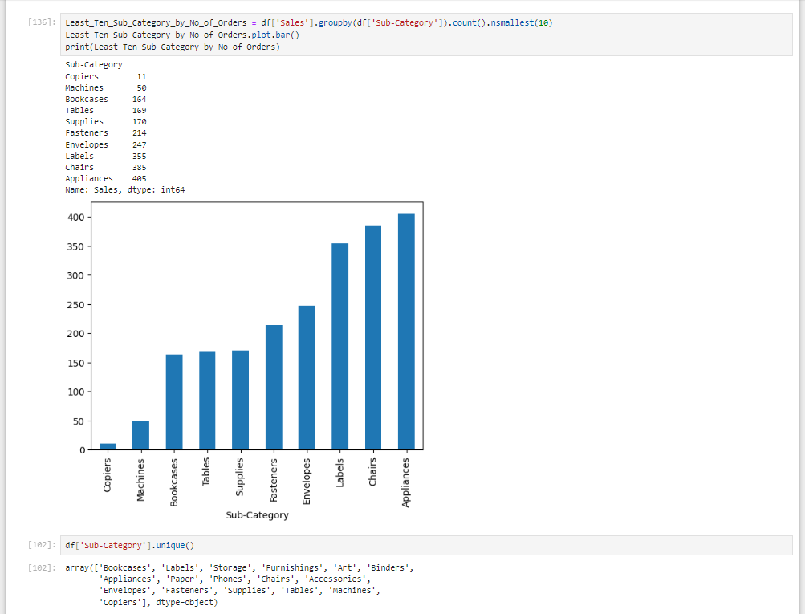
Data Modeling & Data Visualization Using PY

Slide 23
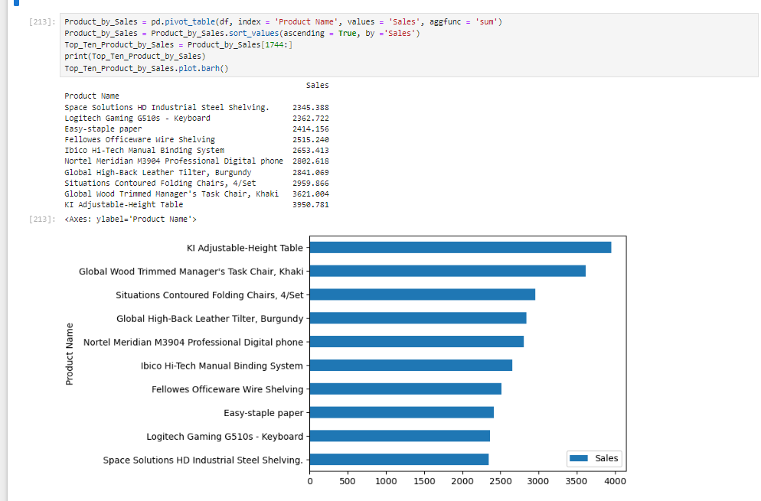
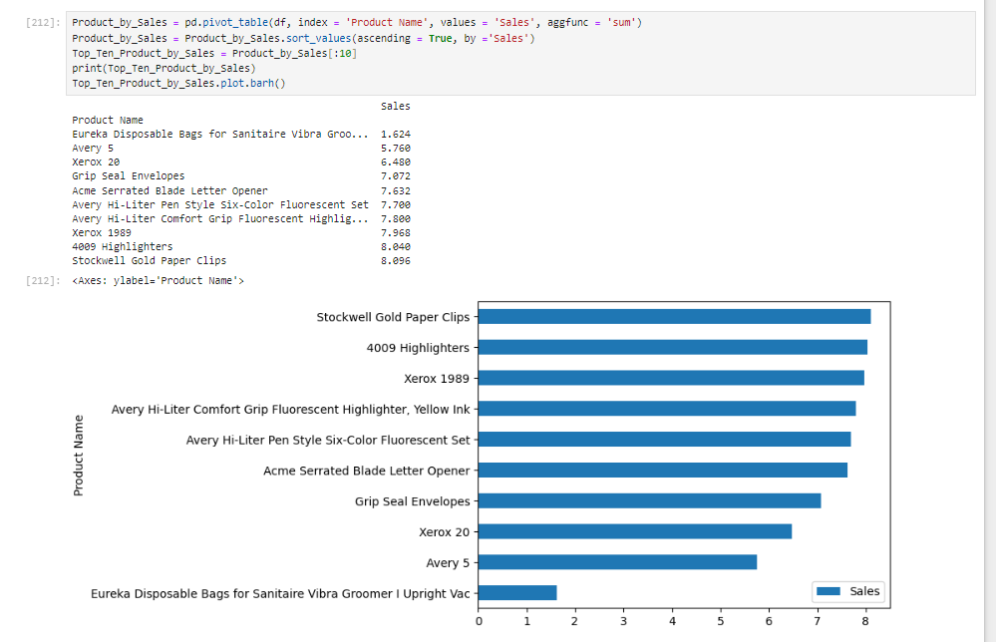
Data Modeling & Data Visualization Using PY

Slide 24
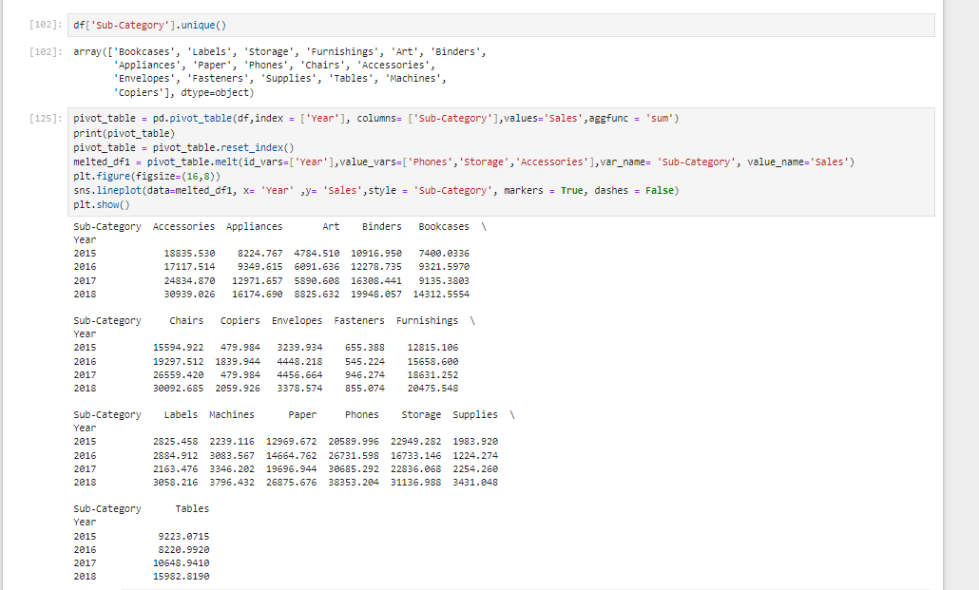
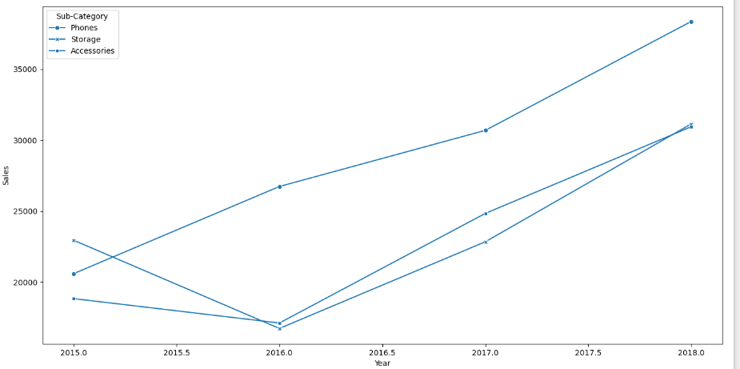
Data Modeling & Data Visualization Using PY

Slide 25
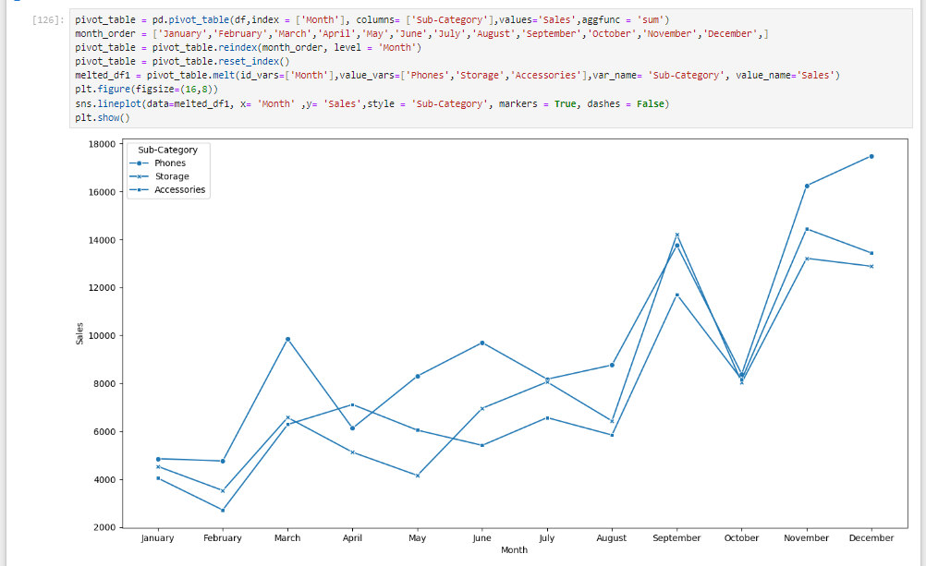
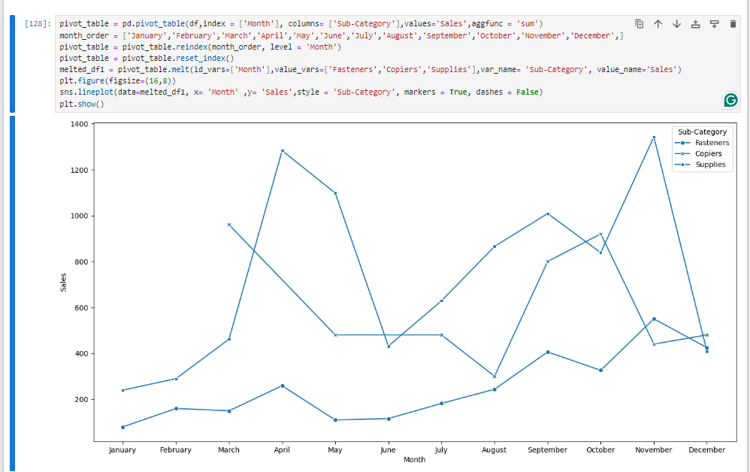
Data Modeling & Data Visualization Using PY

Slide 26
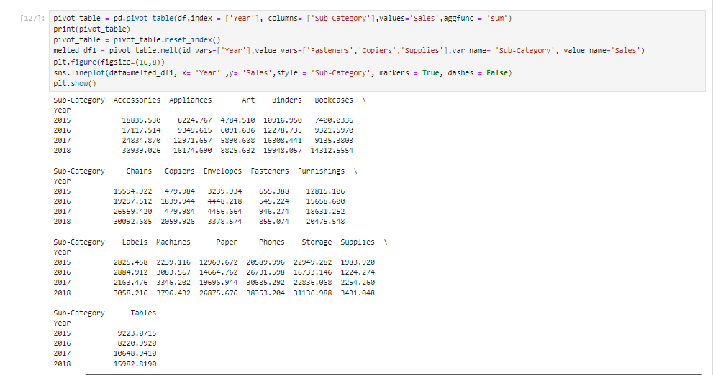
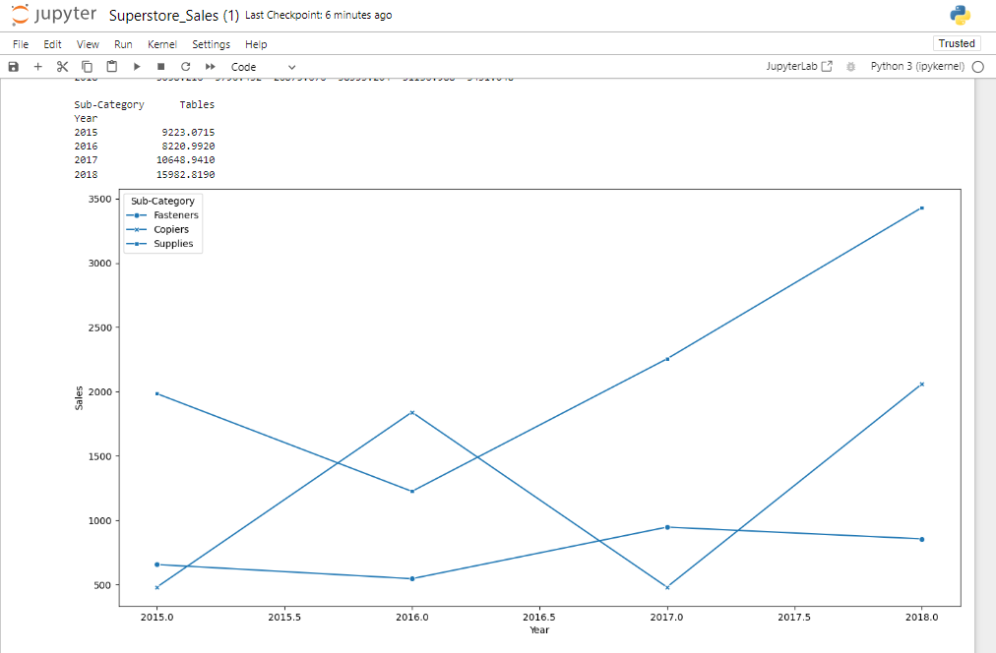
Data Modeling & Data Visualization Using PY

Slide 27
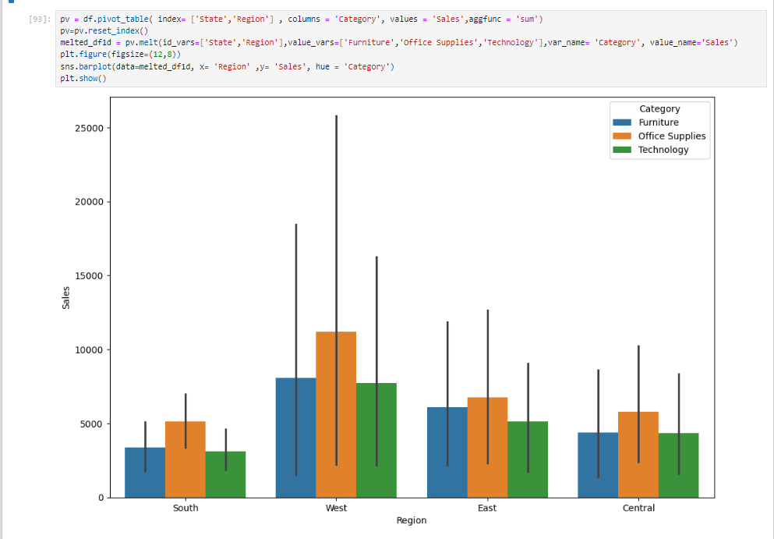
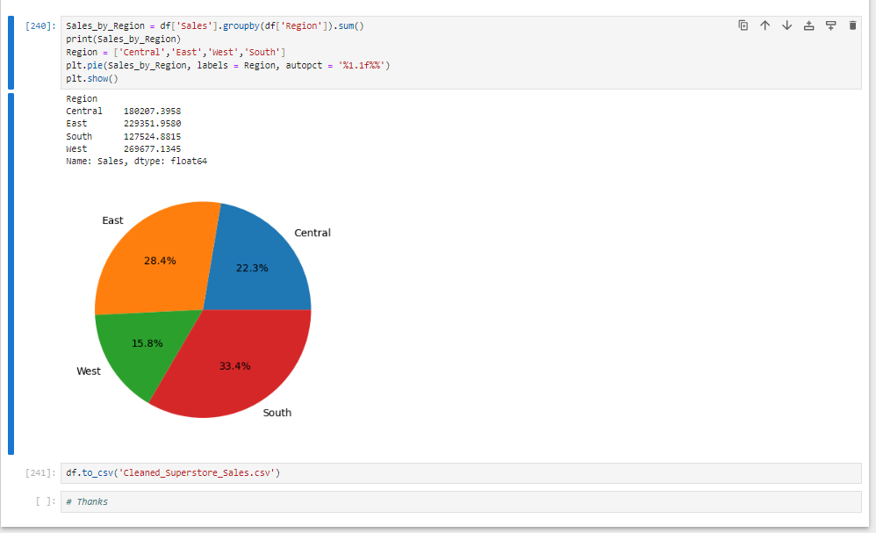
Data Modeling & Data Visualization Using PY

Slide 28
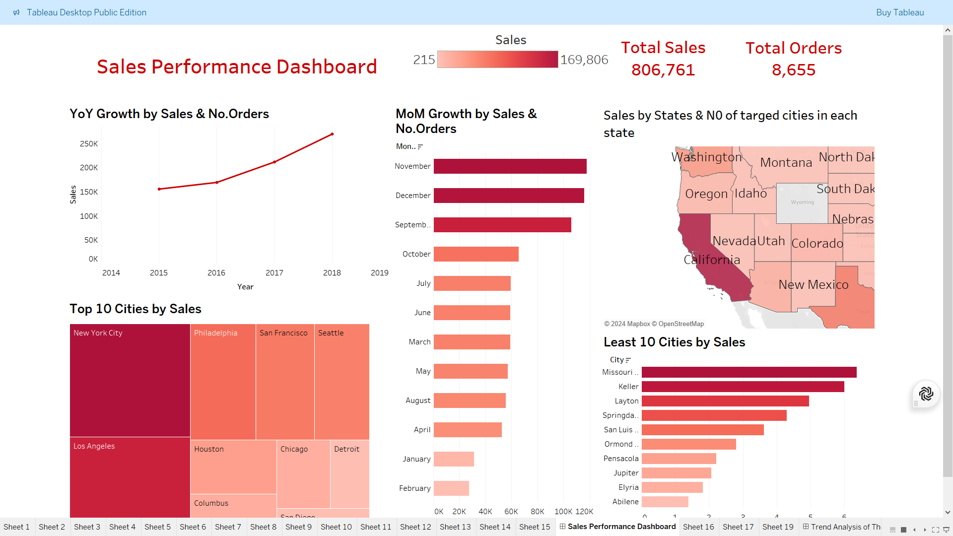
Data Visualization Using Tableau

Slide 29

Data Visualization Using Tableau

Slide 30

Data Visualization Using Tableau

Slide 31

Any Questions ?

Slide 32
Thank You ♥♥

